Slide 1
Extrude sketch to a COMPONENT and add APPEARANCE / Materials

Slide 2
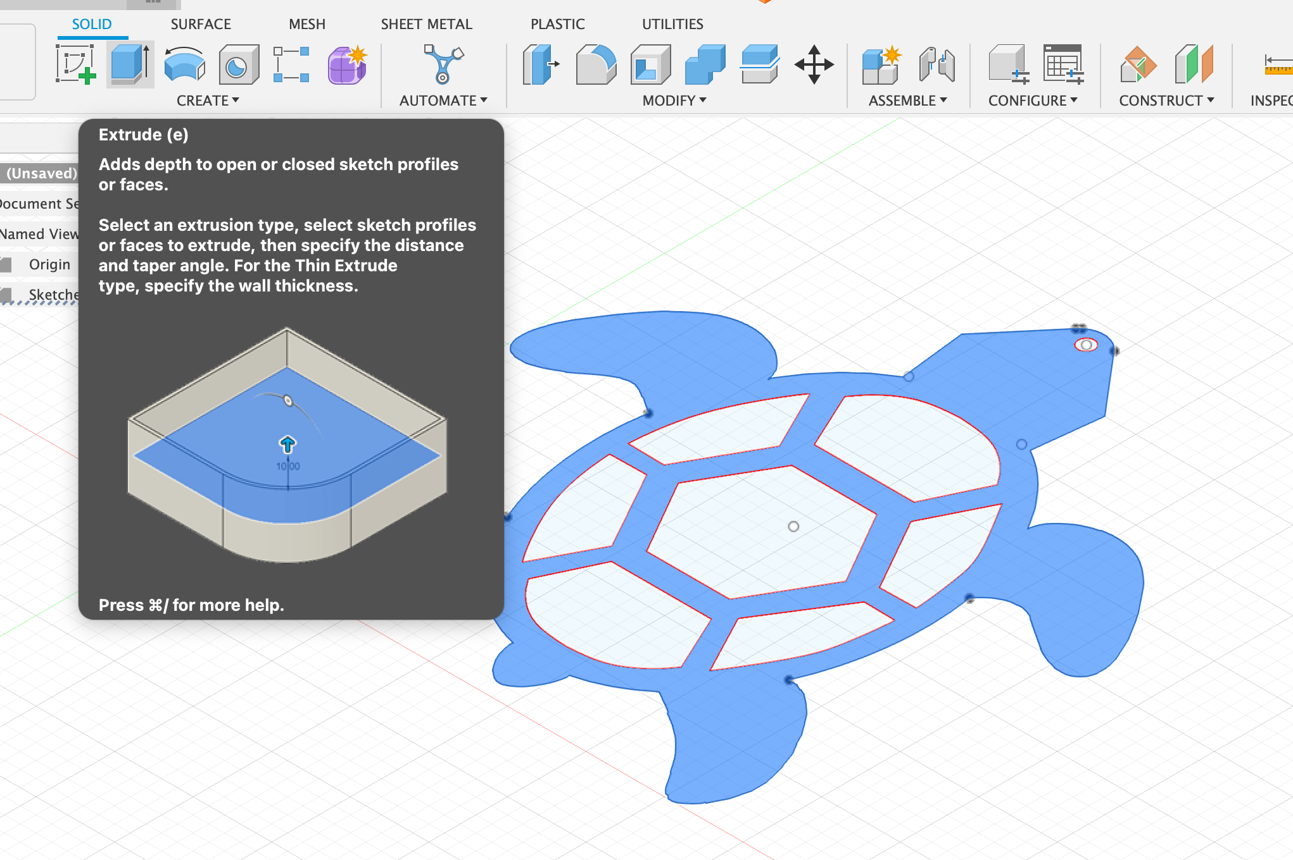
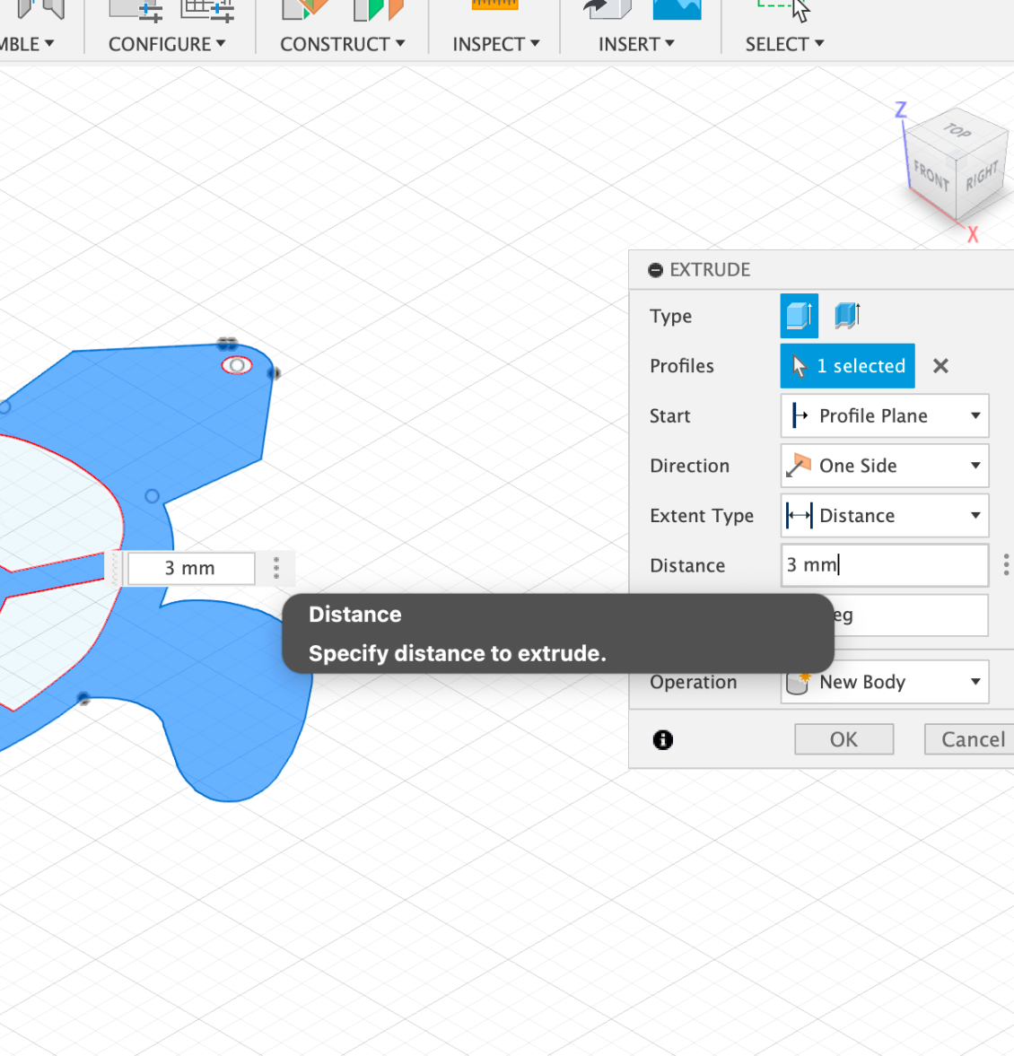
9. Choose positive space for extrusion
10 . extrude 3mm for acrylic

Slide 3
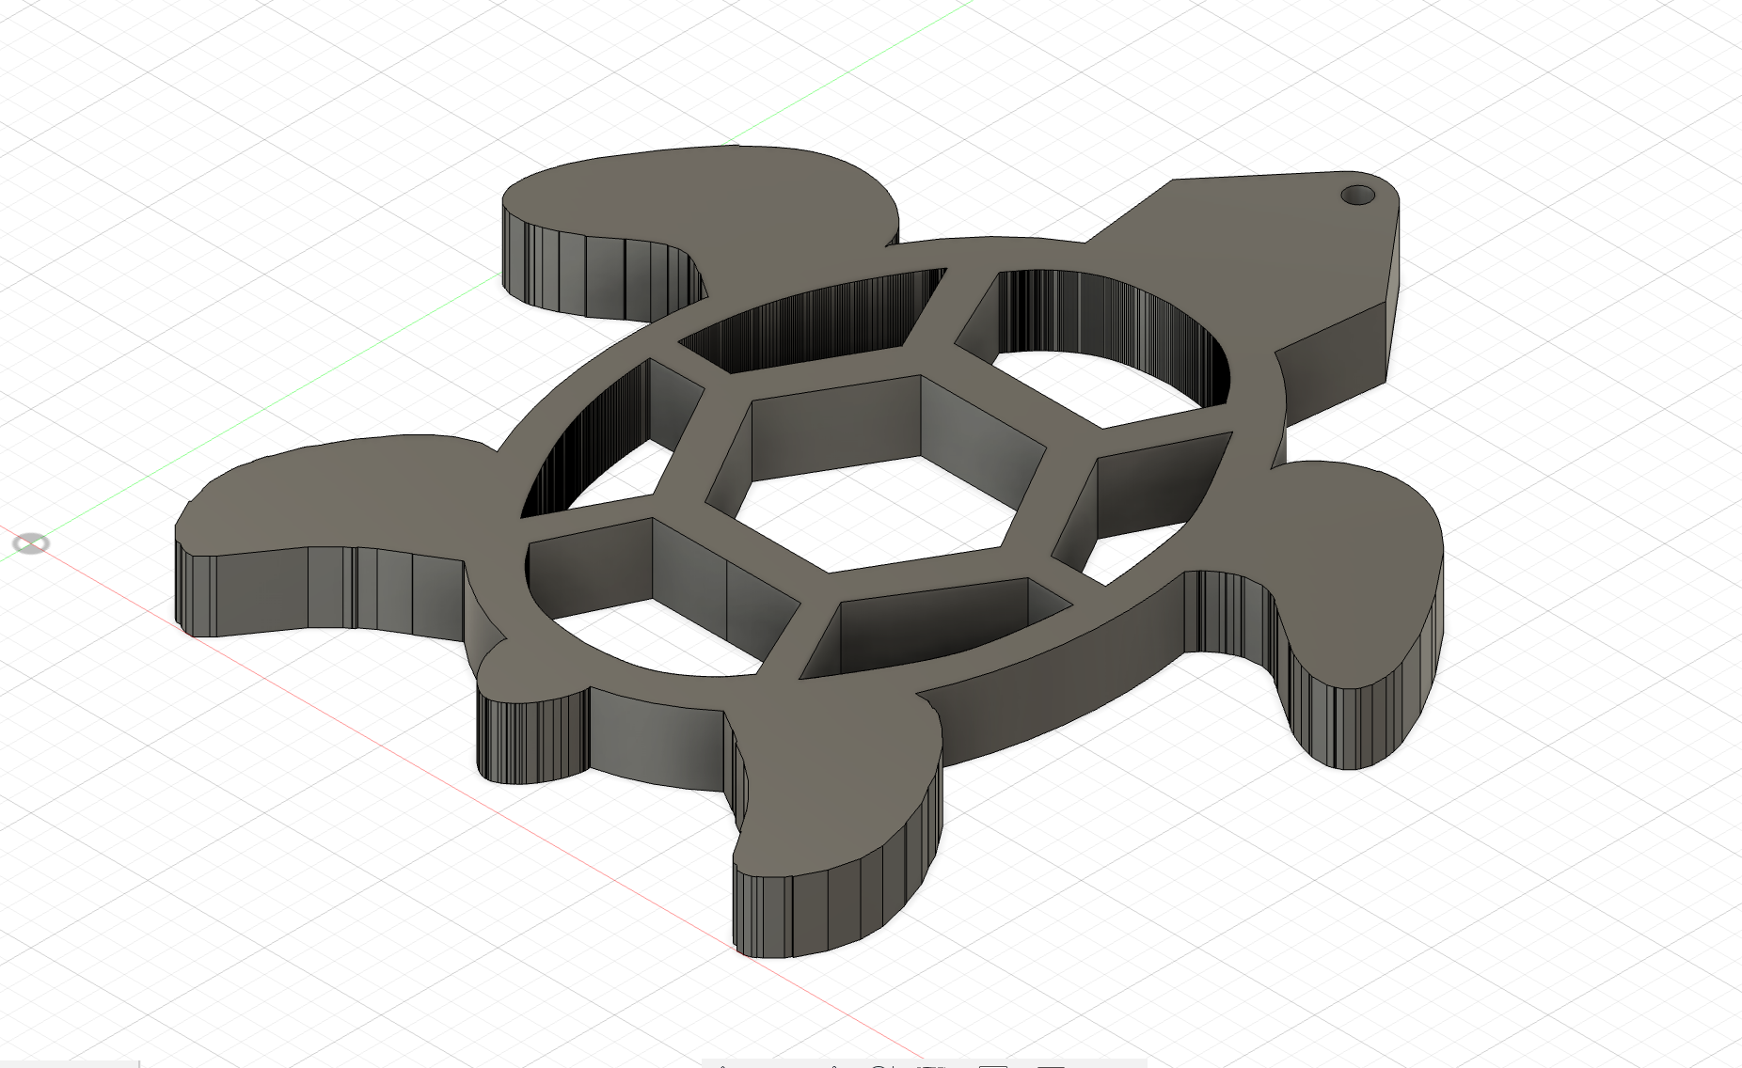
Acrylic product model
enhance by changing the appearance

Slide 4
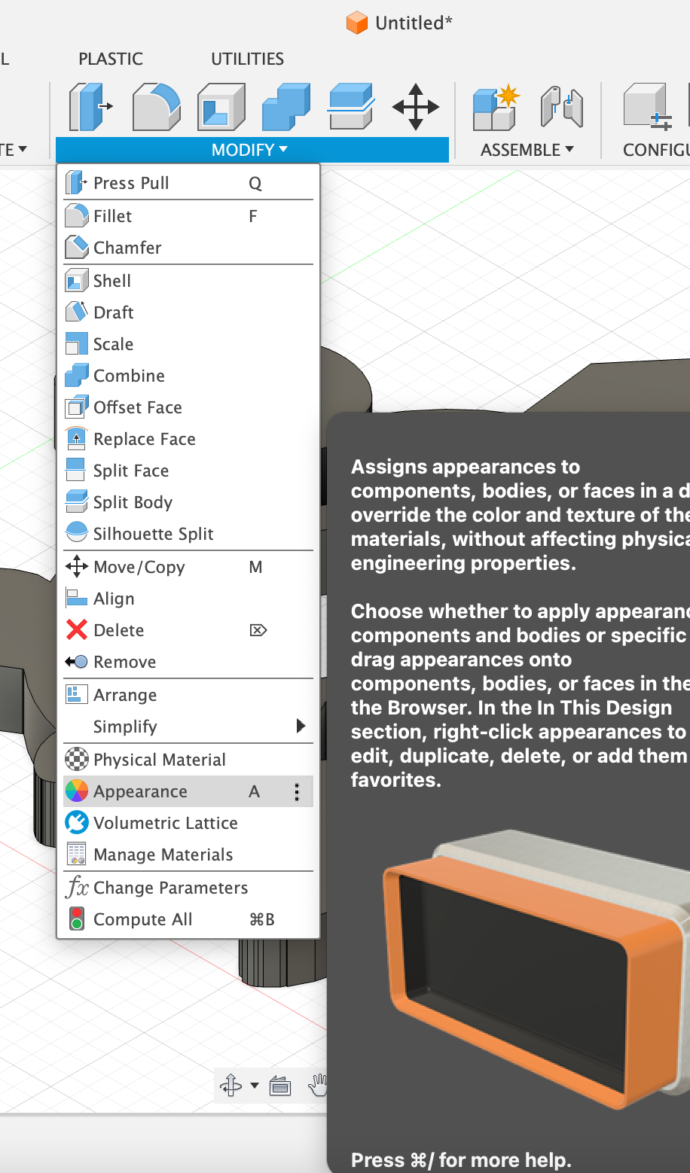
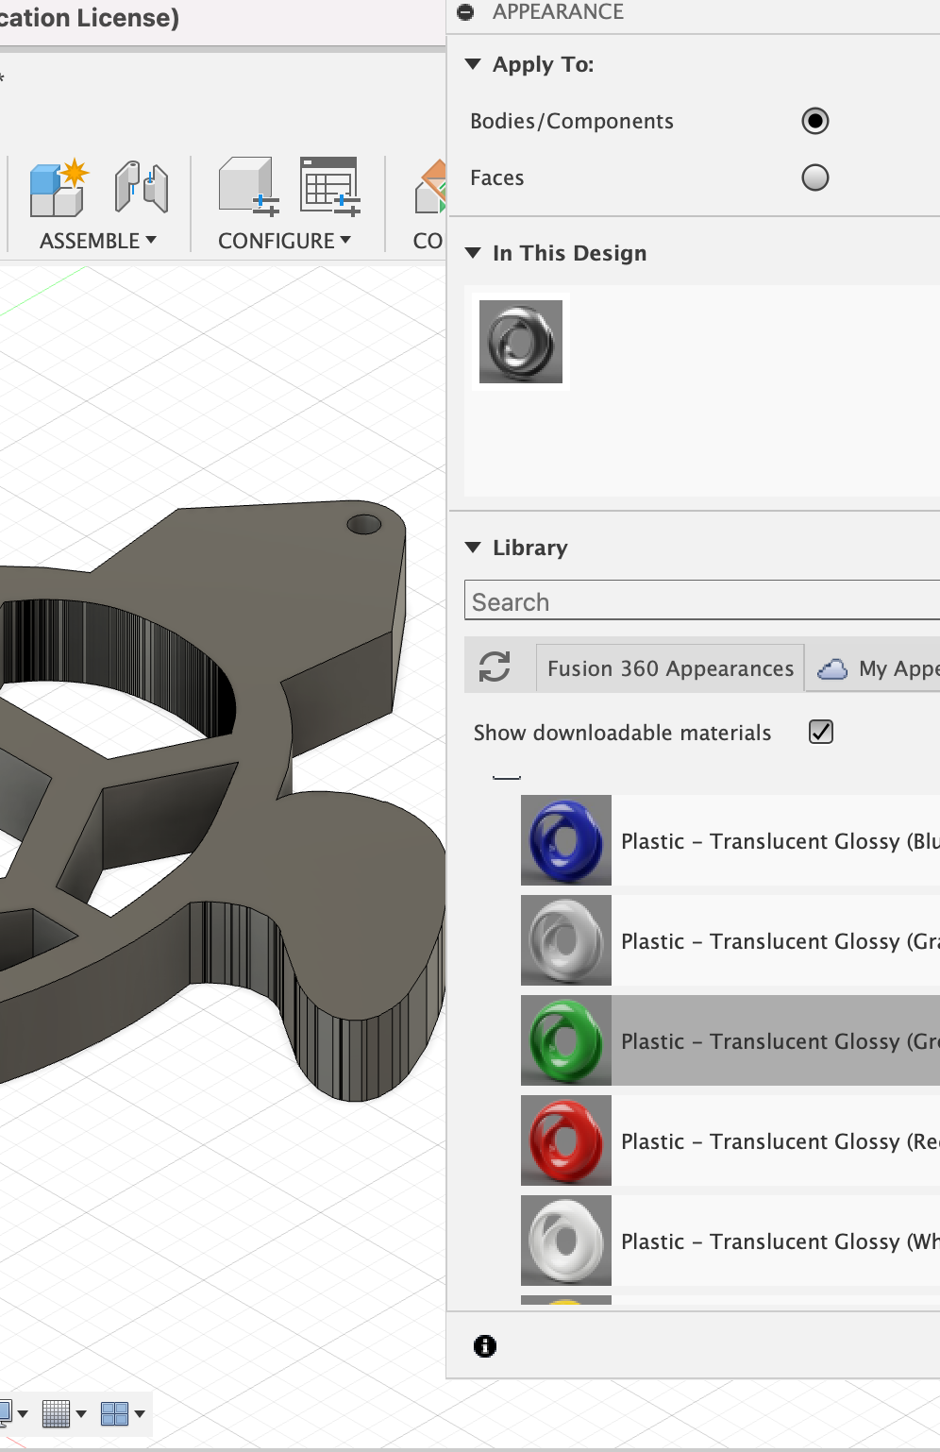
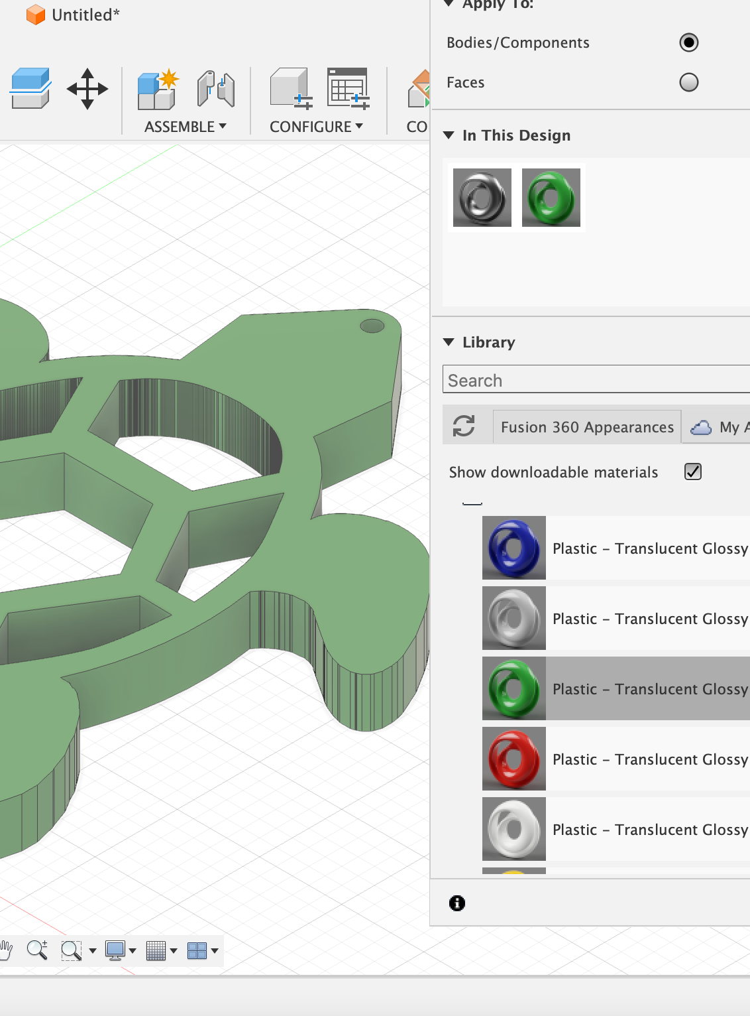
Modify → Appearance
choose material from library
drop onto extruded body

Slide 5
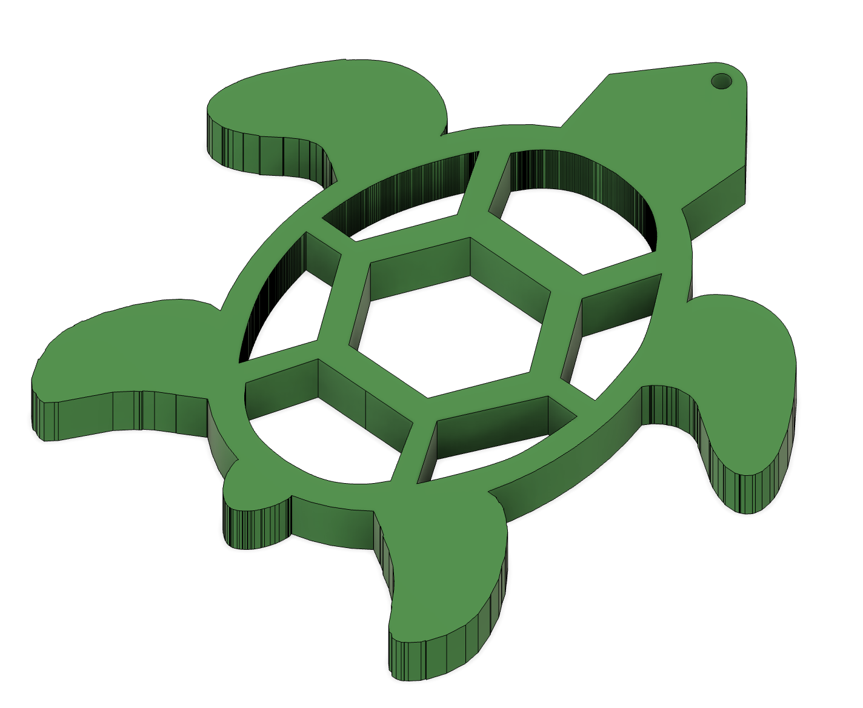
And there is the finished and rendered model!

